Slide 1
Tutorial 5 Creating Advanced Queries and Enhancing Table Design

Slide 2
Objectives
Session 5.1
Review object naming standards
Use the Like, In, Not, and & operators in queries
Filter data using an AutoFilter
Use the IIf function to assign a conditional value to a calculated field in a query
Create a parameter query

Slide 3
Objectives (Cont.)
Session 5.2
Use query wizards to create a crosstab query, a find duplicates query, and a find unmatched query
Create a top values query

Slide 4
Objectives (Cont.)
Session 5.3
Modify table designs using lookup fields, input masks, and data validation rules
Identify object dependencies
Review a Long Text field’s properties
Designate a trusted folder

Slide 5
Creating Advanced Queries and Enhancing Table Design
Case - Chatham Community Health Services
Making the Clinic Database Easier to Use
User is interested in taking better advantage of the power of Access to make the database easier to use and to create more sophisticated queries
User also needs a summarized list of invoice amounts by city

Slide 6
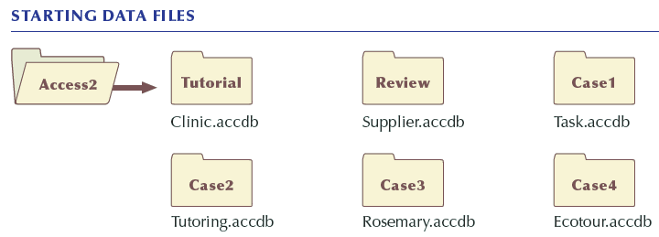
Creating Advanced Queries and Enhancing Table Design (Cont.)

Slide 7
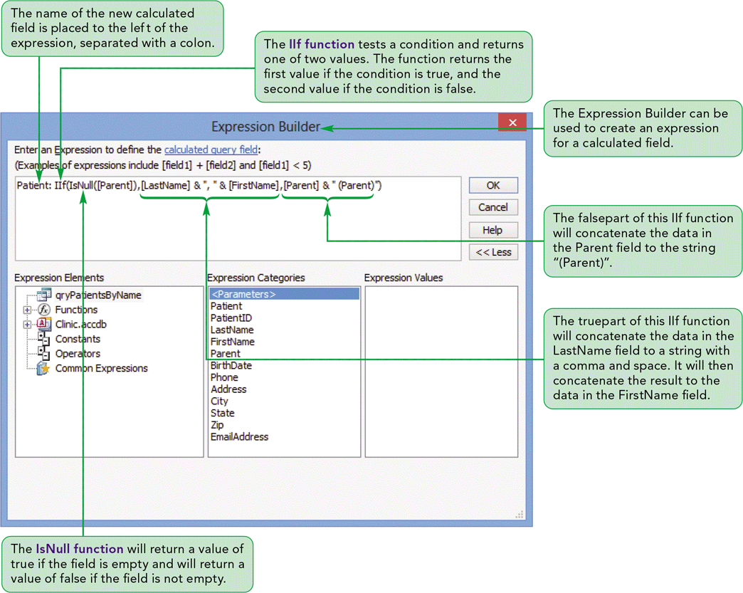
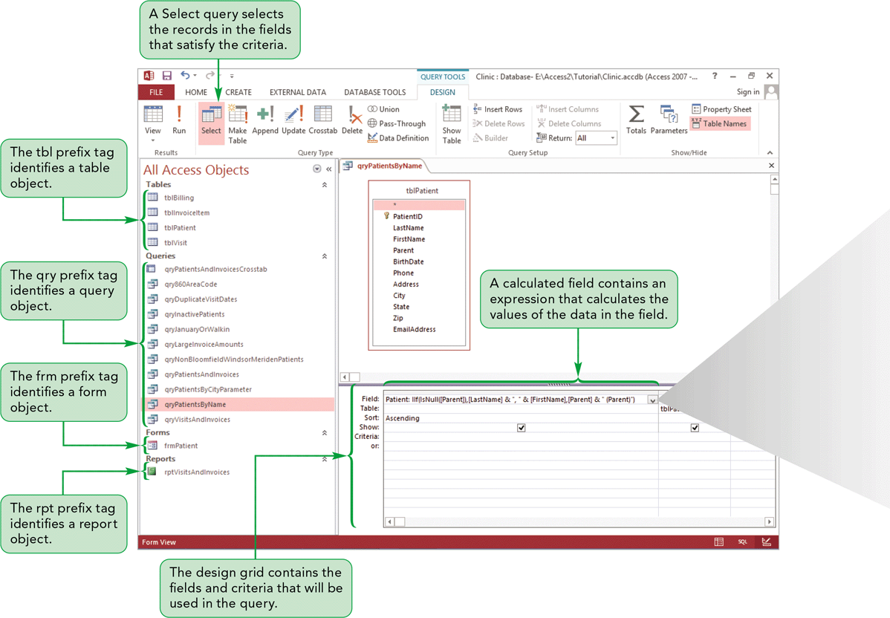
Creating Advanced Queries and Enhancing Table Design (Cont.)

Slide 8
Reviewing the Clinic Database
The Navigation Pane displays the objects grouped by object type
Each object name has a prefix tag—a tbl prefix tag for tables, a qry prefix tag for queries, a frm prefix tag for forms, and a rpt prefix tag for reports
All three characters in each prefix tag are lower case. The word immediately after the three-character prefix begins with an upper case letter
Using object prefix tags, you can readily identify the object type, even when the objects have the same base name
Object names have no spaces, because other database management systems do not permit making it easy during conversions to those systems

Slide 9
Using Pattern Match in a Query
A pattern match selects records with a value for the designated field that matches the pattern of a simple condition value
The Like comparison operator selects records by matching field values to a specific pattern that includes one or more of these wildcard characters: asterisk (*), question mark (?), and number symbol (#)
The asterisk represents any string of characters, the question mark represents any single character, and the number symbol represents any single digit

Slide 10
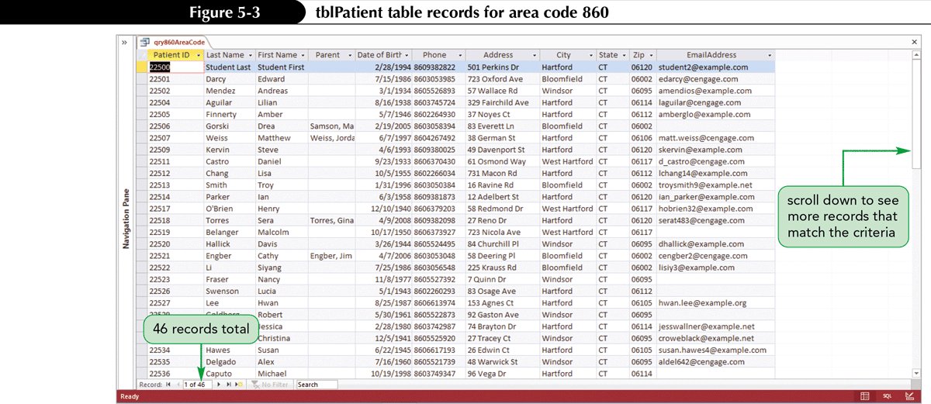
Using Pattern Match in a Query (Cont.)

Slide 11
Using a List-of-Values Match in a Query
A list-of-values match selects records whose value for the designated field matches one of two or more simple condition values
Could include several Or conditions in the design grid, but there is an easier and clearer way to do this
The In comparison operator lets you define a condition with a list of two or more values for a field that select and include those record in the query results

Slide 12
Using the Not Logical Operator in a Query
The Not logical operator negates a criterion or selects records for which the designated field does not match the criterion

Slide 13
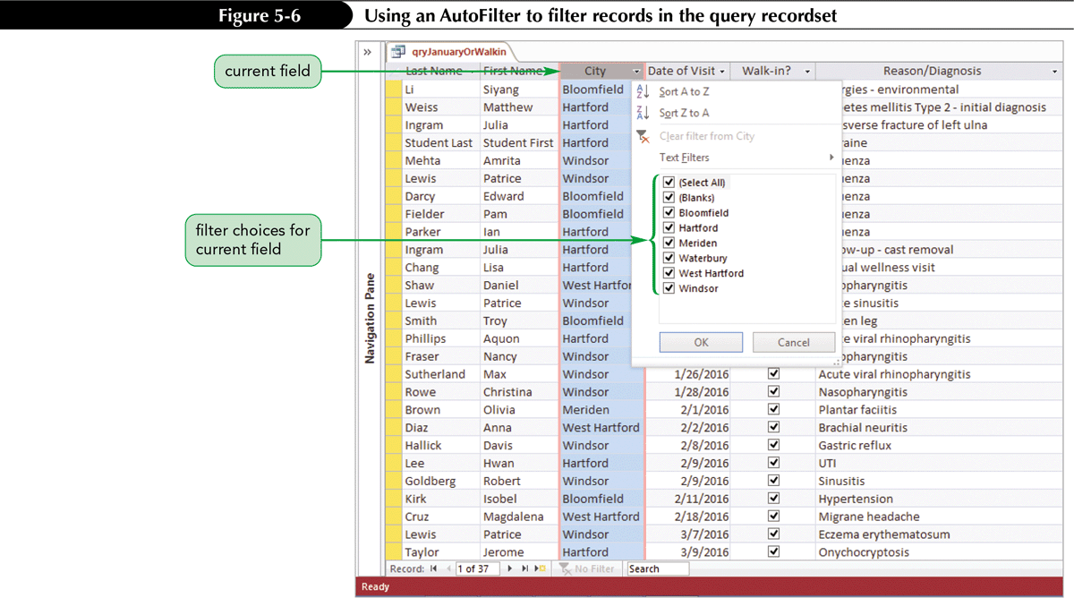
Using an AutoFilter to Filter Data
You can use the AutoFilter feature to choose restrictions faster and with more flexibility than using the condition and Or logical operator

Slide 14
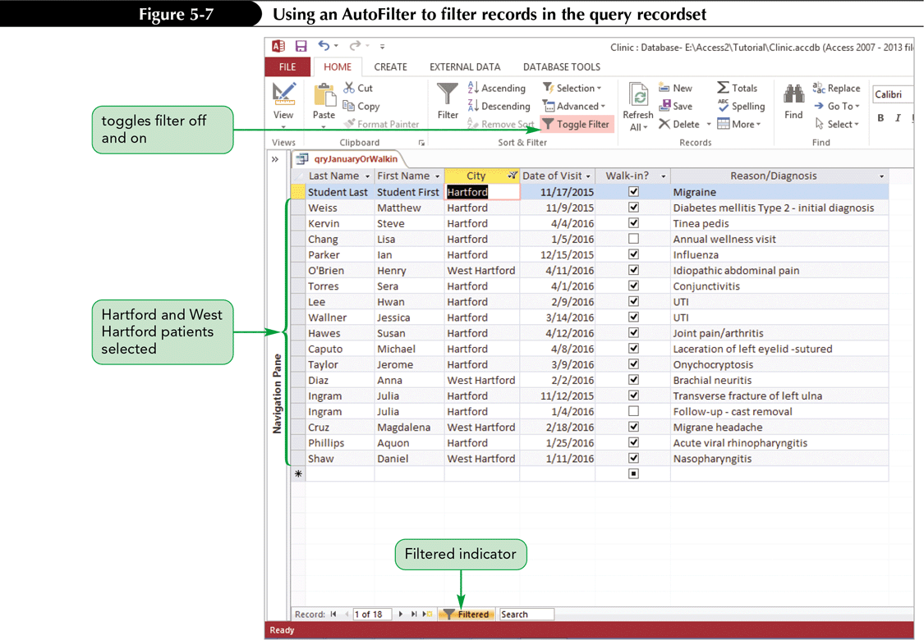
Using an AutoFilter to Filter Data (Cont.)

Slide 15
Assigning a Conditional Value to a Calculated Field
Null Fields are fields in a record does not contain any information at all
A field in a record that contains any data at all—even a single space—is nonnull
To combine nonnull LastName and FirstName fields, you can use the expression LastName & “, “ & FirstName
The & (ampersand) operator is a concatenation operator that joins text expressions
Concatenation refers to joining two or more text fields or characters encapsulated in quotes

Slide 16
Assigning a Conditional Value to a Calculated Field (Cont.)
The IIf (Immediate If) function assigns one value to a calculated field or control if a condition is true, and a second value if the condition is false
The IIf function has three parts: a condition that is true or false, the result when the condition is true, and the result when the condition is false
Each part of the IIf function is separated by a comma
The IsNull function tests a field value or an expression for a null value; if the field value or expression is null, the result is true; otherwise, the result is false

Slide 17
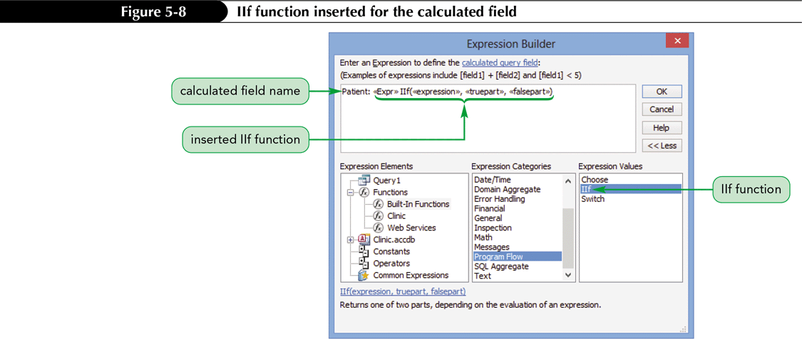
Assigning a Conditional Value to a Calculated Field (Cont.)

Slide 18
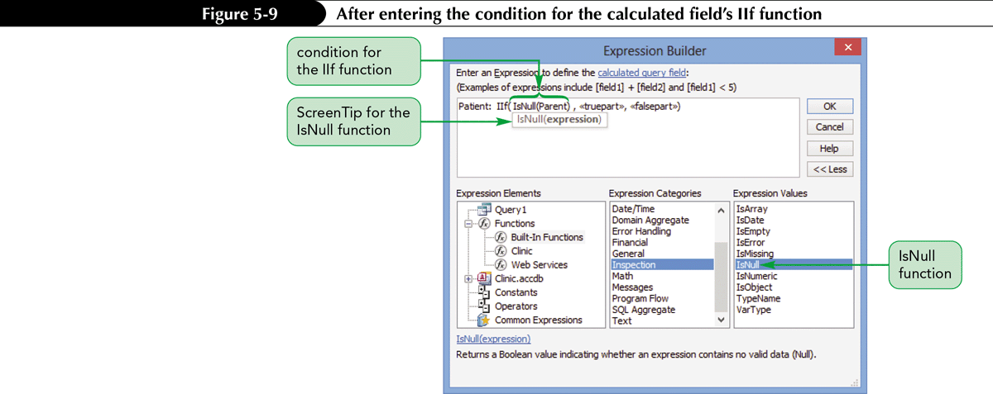
Assigning a Conditional Value to a Calculated Field (Cont.)

Slide 19
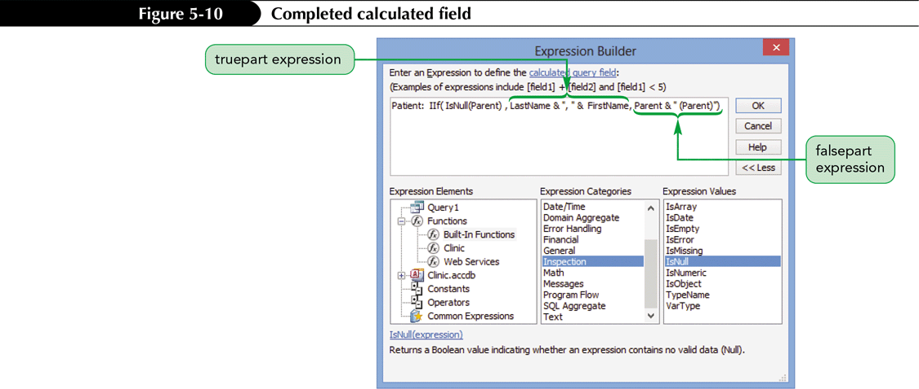
Assigning a Conditional Value to a Calculated Field (Cont.)

Slide 20
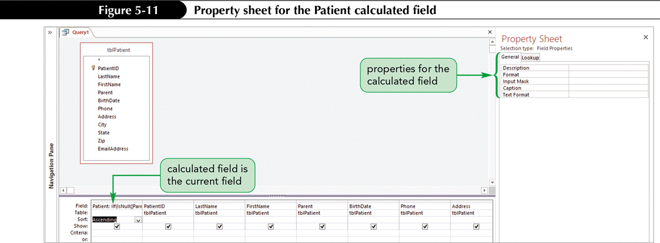
Assigning a Conditional Value to a Calculated Field (Cont.)

Slide 21
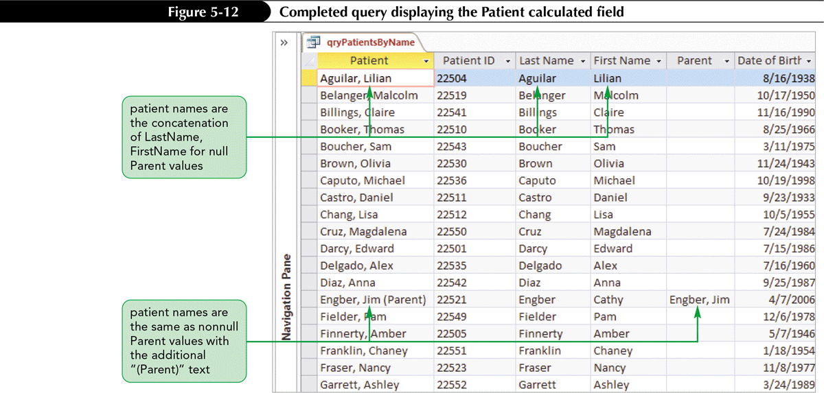
Assigning a Conditional Value to a Calculated Field (Cont.)

Slide 22
Creating a Parameter Query
A parameter query displays a dialog box that prompts the user to enter one or more criteria values when the query is run
The value entered into the prompt causes the query to select only those records with field value from the table

Slide 23
Creating a Parameter Query (Cont.)

Slide 24
Creating a More Flexible Parameter Query
Most users want a parameter query to display the records that match the parameter value the user enters or to display all records when the user doesn’t enter a parameter value
To provide this functionality, you can change the value in the Criteria box in the design grid for the specified column
Prefix the Like operator to the original criterion and concatenate the criterion to a wildcard character

Slide 25
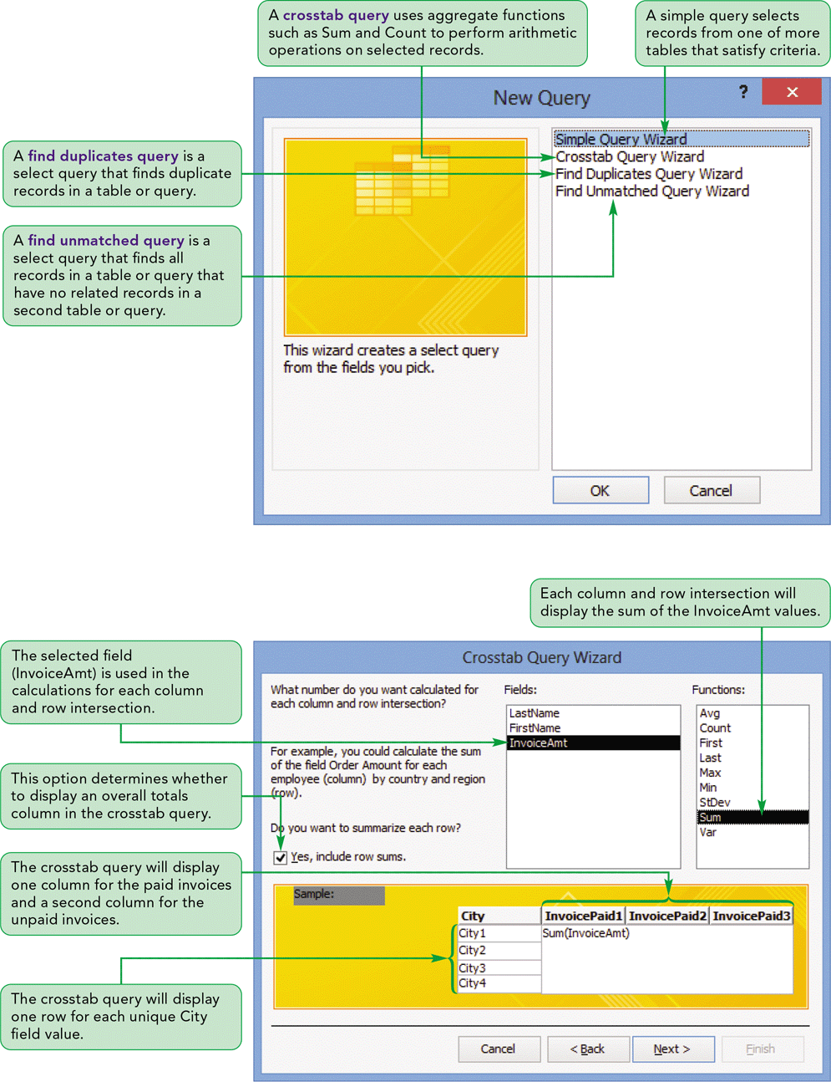
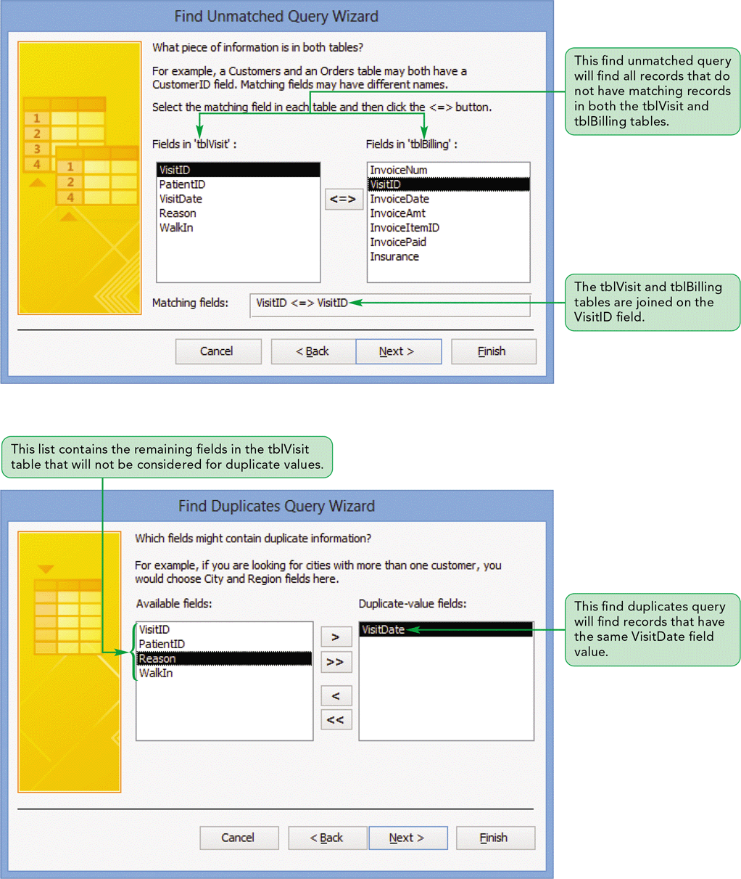
Advanced Query Wizards

Slide 26
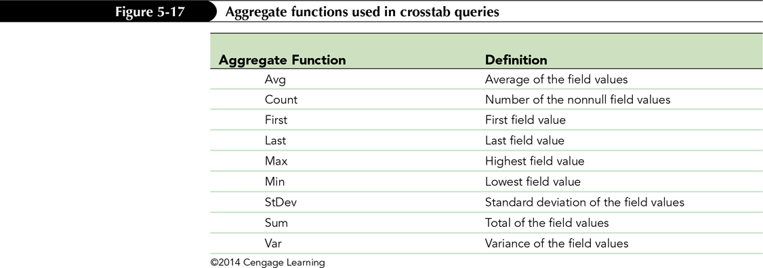
Creating a Crosstab Query

Slide 27
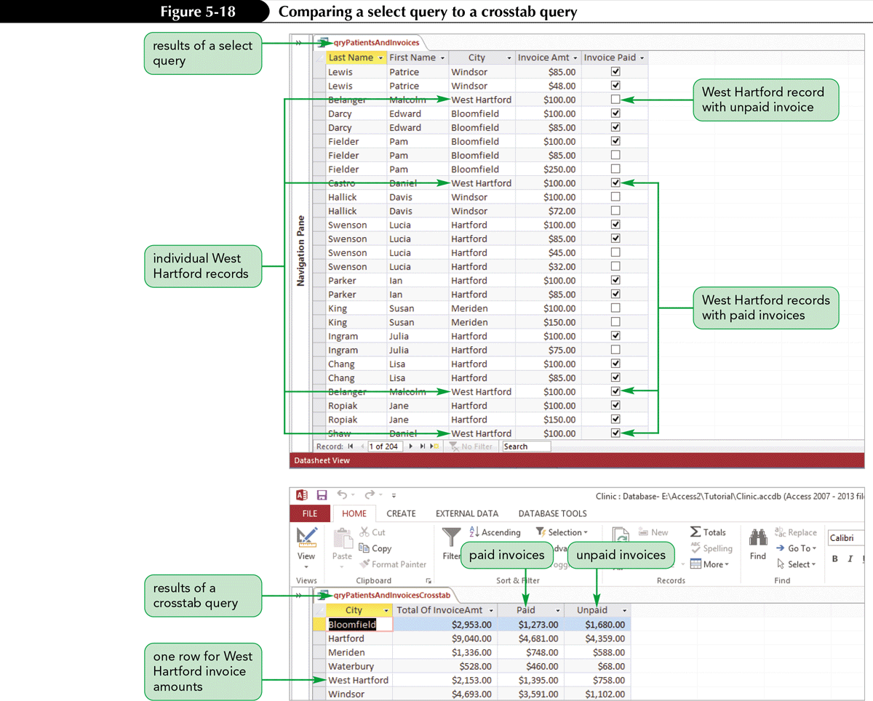
Creating a Crosstab Query (Cont.)

Slide 28
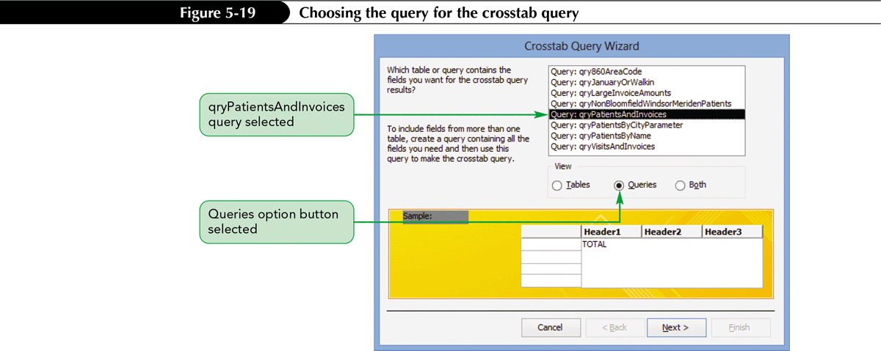
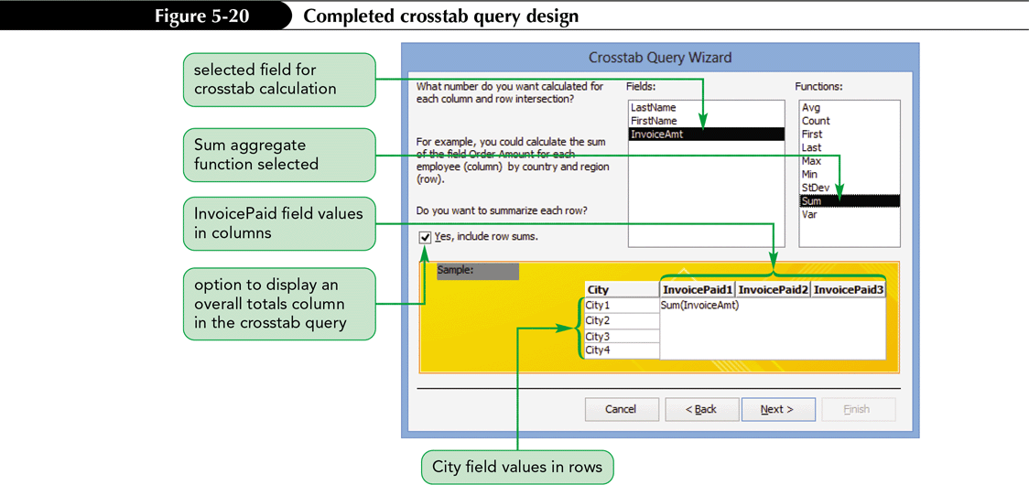
Creating a Crosstab Query (Cont.)
The quickest way to create a crosstab query is to use the Crosstab Query Wizard

Slide 29
Creating a Crosstab Query (Cont.)

Slide 30
Creating a Crosstab Query (Cont.)

Slide 31
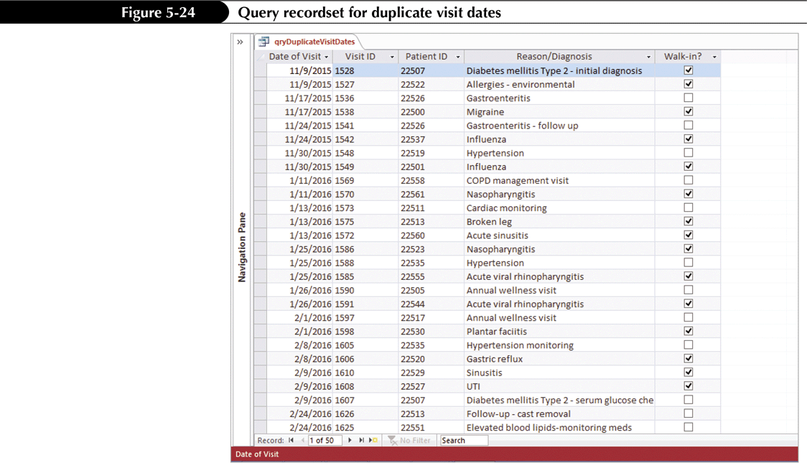
Creating a Find Duplicates Query
A find duplicates query is a select query that finds duplicate records in a table or query
You can create this type of query using the Find Duplicates Query Wizard
A find duplicates query searches for duplicate values based on the fields you select when answering the Wizard’s questions

Slide 32
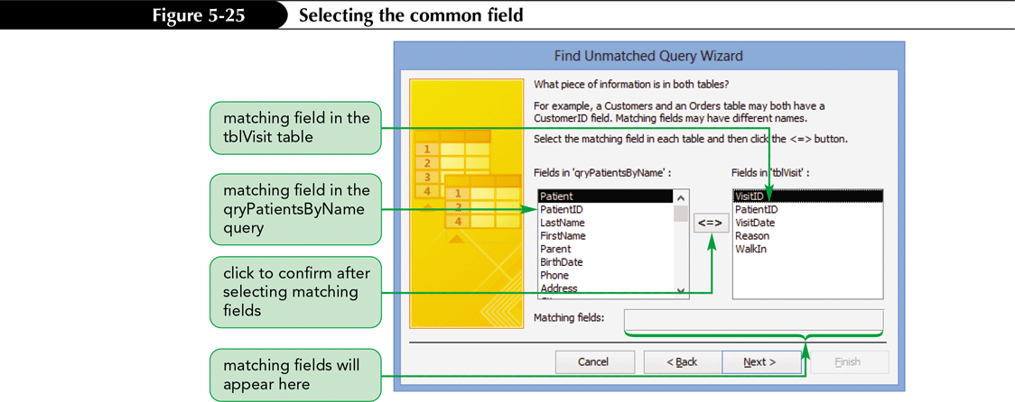
Creating a Find Unmatched Query
A find unmatched query is a select query that finds all records in a table or query that have no related records in a second table or query
Use the Find Unmatched Query Wizard to create this type of query

Slide 33
Creating a Find Unmatched Query (Cont.)

Slide 34
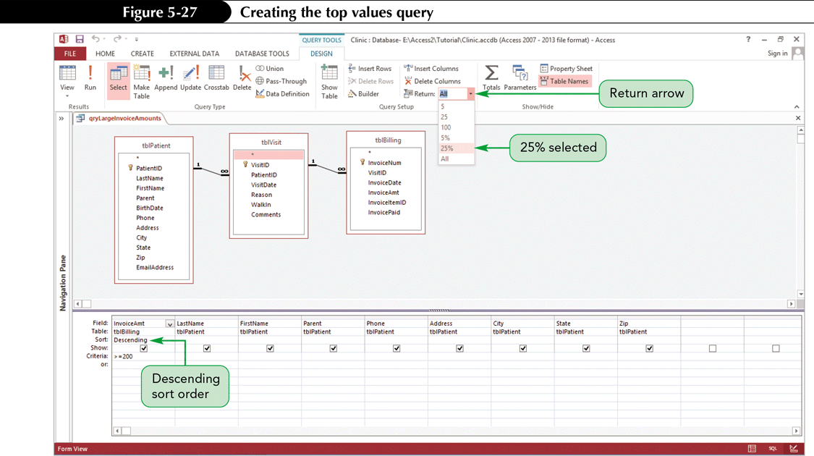
Creating a Top Values Query
Users might want to limit the number to a more manageable size by displaying, for example, just the first 10 records
The Top Values property for a query lets you limit the number of records in the query results

Slide 35
Creating a Top Values Query (Cont.)

Slide 36
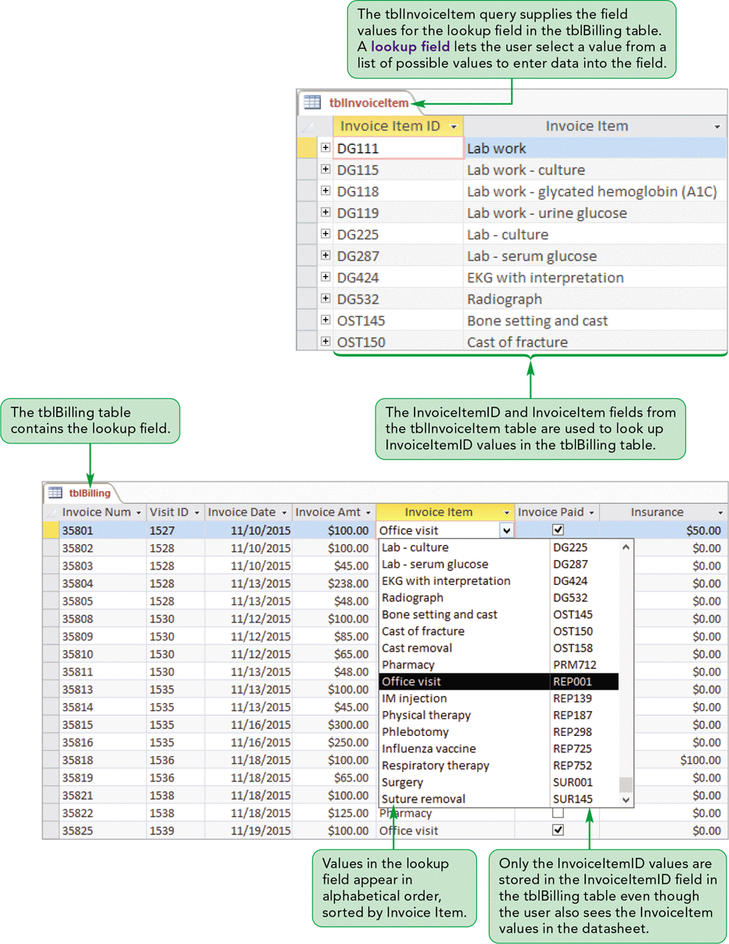
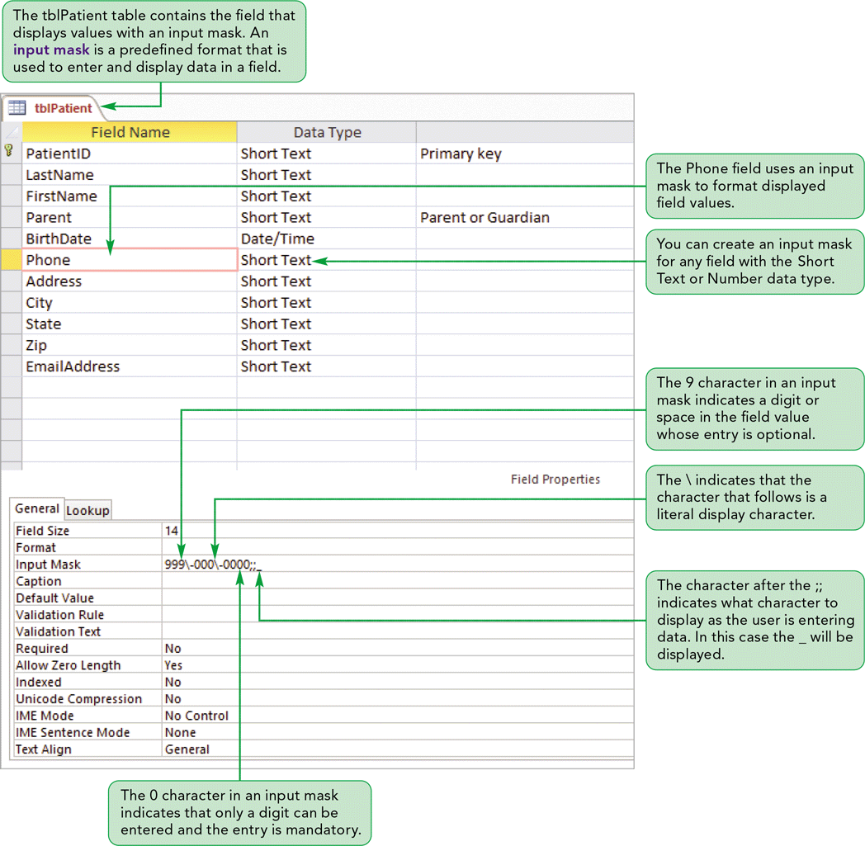
Lookup Fields and Input Masks

Slide 37
Creating a Lookup Field
Data entry is easier if users do not need to remember the correct values for fields
A lookup field lets the user select a value from a list of possible value
Use a Lookup Wizard field in Access to create a lookup field in a table

Slide 38
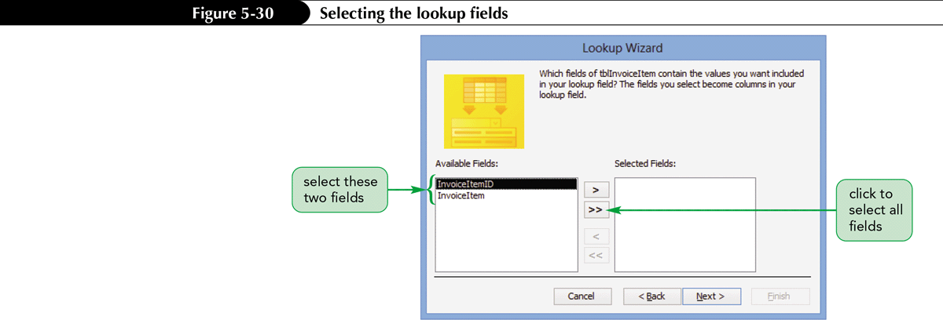
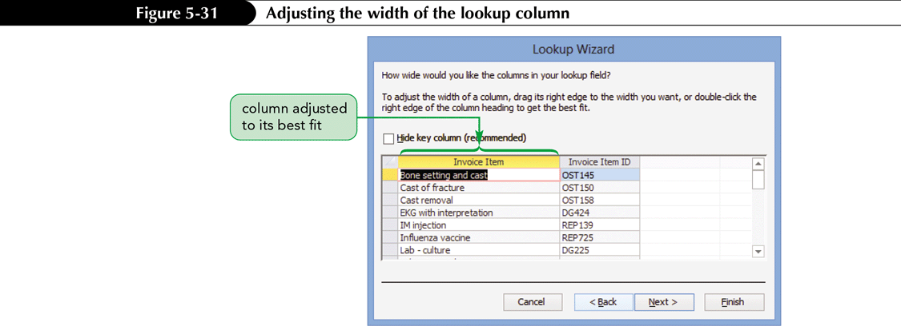
Creating a Lookup Field (Cont.)

Slide 39
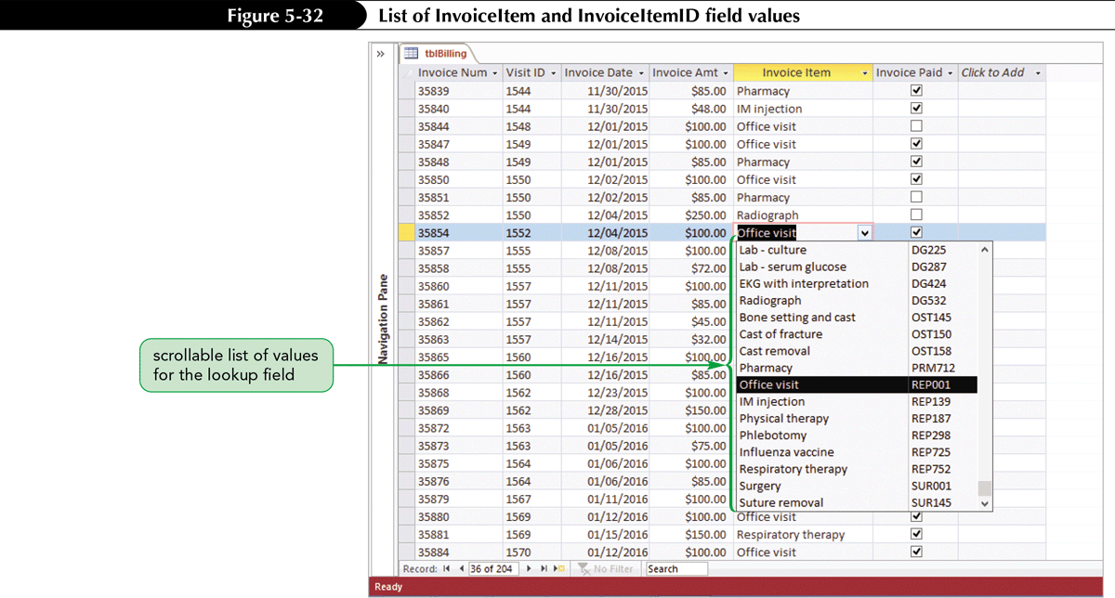
Creating a Lookup Field (Cont.)

Slide 40
Using the Input Mask Wizard
A literal display character is a special character that automatically appears in specific positions of a field value – like hyphens in a social security number
To include these characters, you need to create an input mask, which is a predefined format used to enter and display data in a field
An easy way to create an input mask is to use the Input Mask Wizard which guides you in creating a predefined format for a field
You must be in Design view to use the Input Mask Wizard

Slide 41
Using the Input Mask Wizard (Cont.)

Slide 42
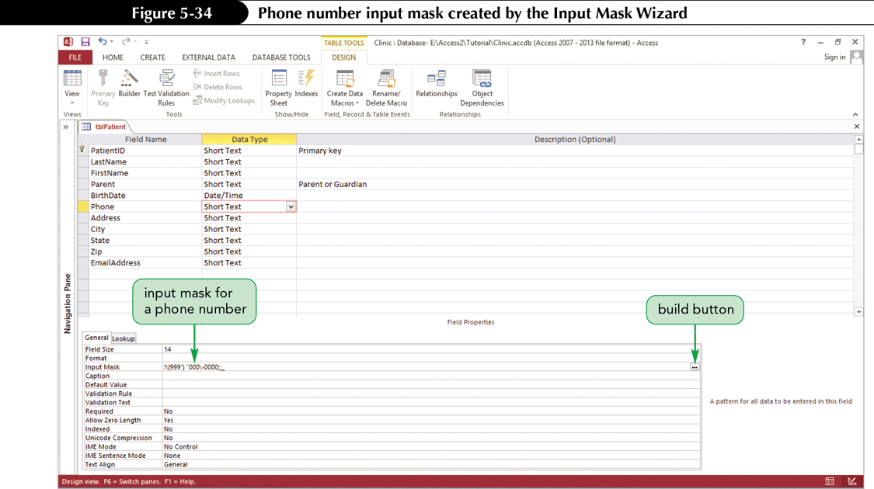
Using the Input Mask Wizard (Cont.)

Slide 43
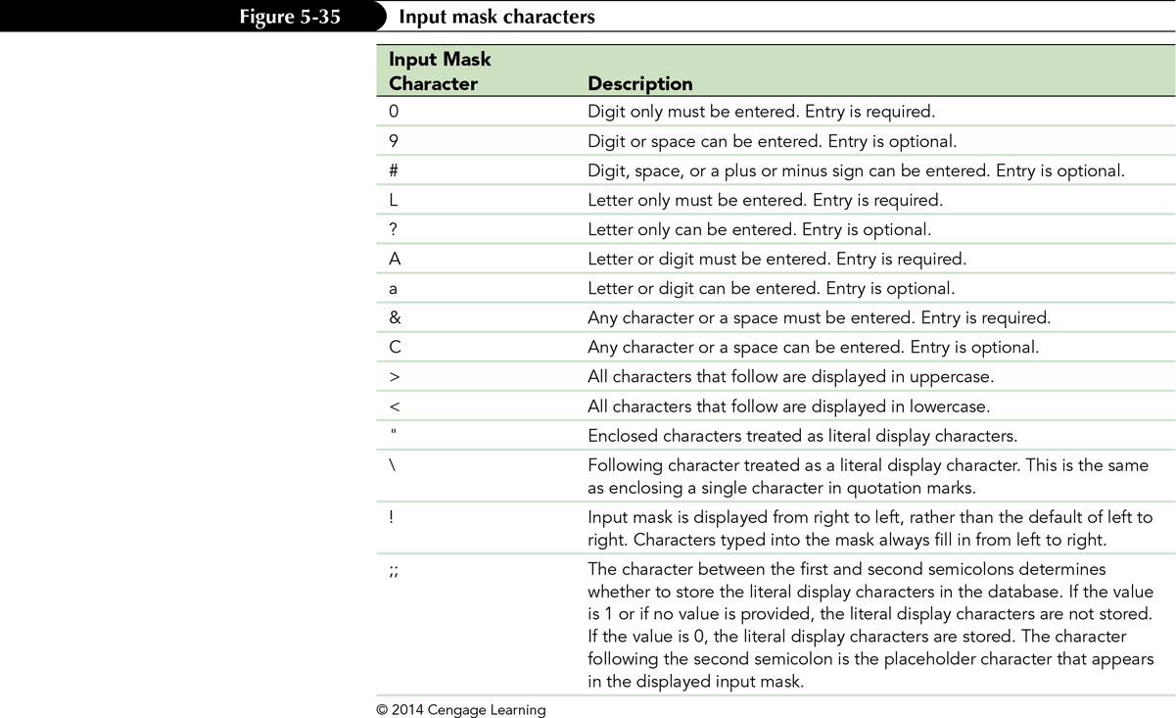
Using the Input Mask Wizard (Cont.)

Slide 44
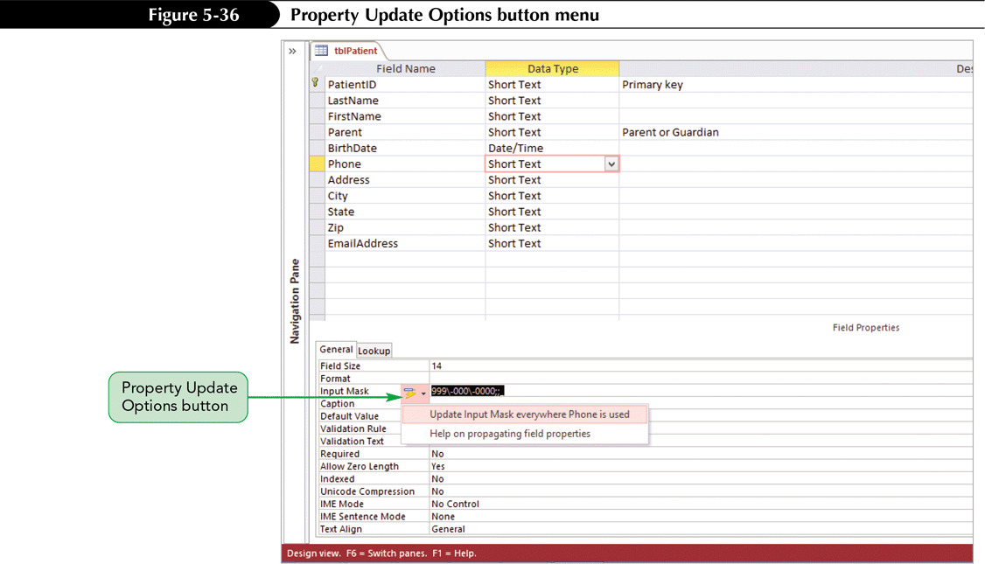
Using the Input Mask Wizard (Cont.)

Slide 45
Using the Input Mask Wizard (Cont.)

Slide 46
Identifying Object Dependencies
An object dependency exists between two objects when a change to the properties of data in one object affects the properties of data in the other object
Dependencies between Access objects, such as tables, queries, and forms, can occur as relationships or using a query to obtain values from more than one table.
Any form or report that uses fields from a query is directly dependent on the query and is indirectly dependent on the tables that provide the data to the query
The Object Dependencies pane displays a collapsible list of the dependencies among the objects in an Access database

Slide 47
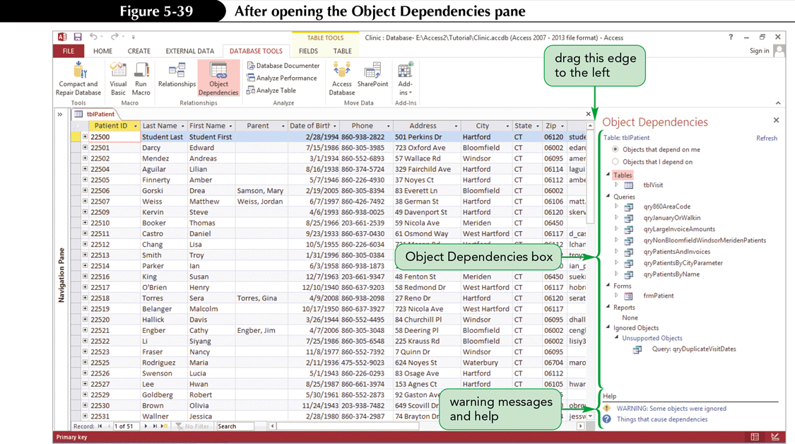
Identifying Object Dependencies (Cont.)

Slide 48
Defining Data Validation Rules
Defining Field Validation Rules
To prevent a user from entering an unacceptable value in a field, you can create a field validation rule that verifies a field value by comparing it to a constant or to a set of constants
You create a field validation rule by setting the Validation Rule and the Validation Text field properties
The Validation Rule property value specifies the valid values that users can enter in a field.
The Validation Text property value will be displayed in a dialog box if a user enters an invalid value

Slide 49
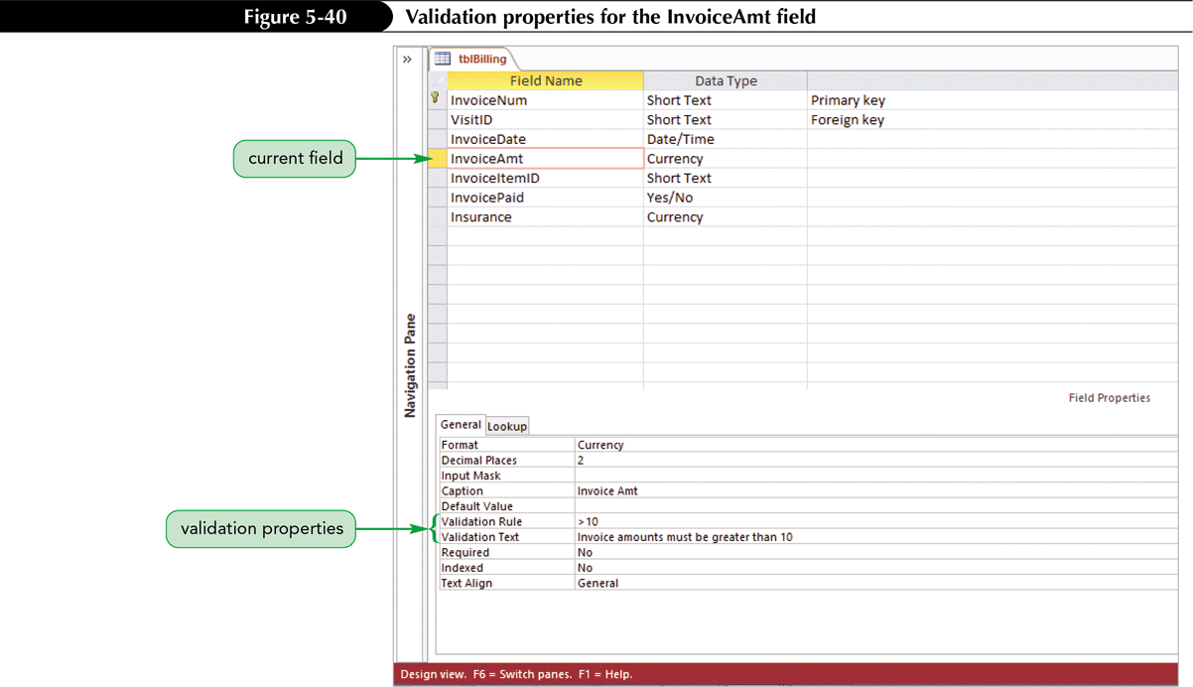
Defining Data Validation Rules (Cont.)

Slide 50
Defining Data Validation Rules (Cont.)
Defining Table Validation Rules
To make sure that the value a user enters is not larger than the maximum field value, you can create a table validation rule
Use the Validation Rule and Validation Text properties and set these properties for the table instead of for an individual field
Use a table validation rule because this validation involves multiple fields
A field validation rule is used when the validation involves a restriction for only the selected field, and does not depend on other fields

Slide 51
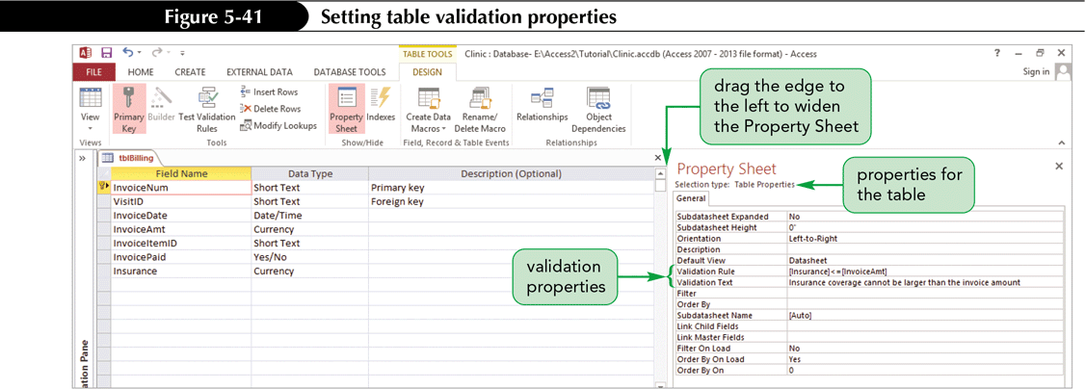
Defining Data Validation Rules (Cont.)

Slide 52
Working with Long Text Fields
Use a Long Text field to store long comments and explanations
Short Text fields are limited to 255 characters, but Long Text fields can hold up to 65,535 characters
Short Text fields limit you to plain text with no special formatting
Long Text fields store plain text similar to Short Text fields or to store rich text, which you can selectively format with options such as bold, italic, and different fonts and colors

Slide 53
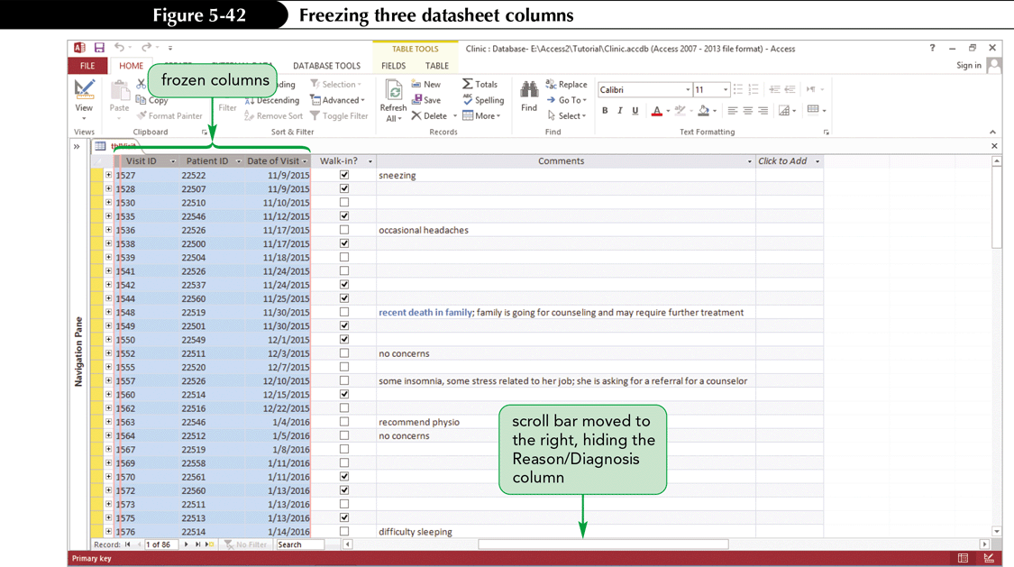
Working with Long Text Fields (Cont.)

Slide 54
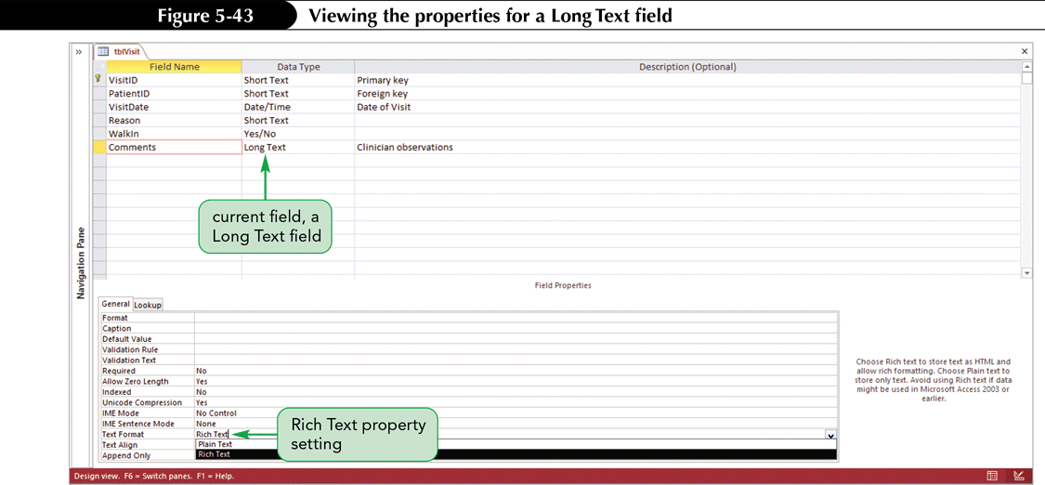
Working with Long Text Fields (Cont.)

Slide 55
Designating a Trusted Folder
A database is a file, and files can contain malicious instructions that can damage other files on your computer or files on other computers on your network
Unless you take special steps, Access treats every database as a potential threat to your computer
One special step that you can take is to designate a folder as a trusted folder which is a folder on a drive or network that you designate as trusted and where you place databases you know are safe

Slide 56
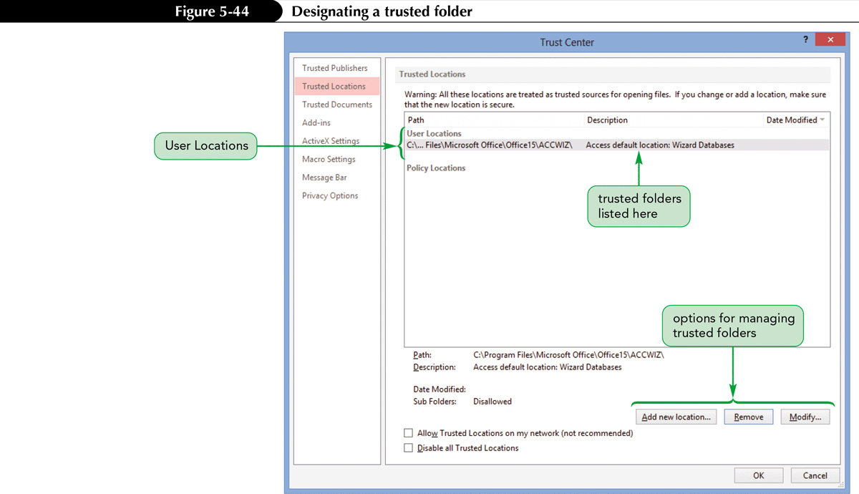
Designating a Trusted Folder (Cont.)

